Slide 1

Tailoring of Nonlinear Waves by Purposeful Introduction of Defects in Periodic Mechanical Metamaterials: Phase Space Analysis
USNC/TAM 2022
Mohammed A. Mohammed, Ph.D. student
Piyush Grover, Assistant Professor
Dynamical Systems Lab
Mechanical and Materials Engineering
University of Nebraska-Lincoln, NE, USA

Slide 2
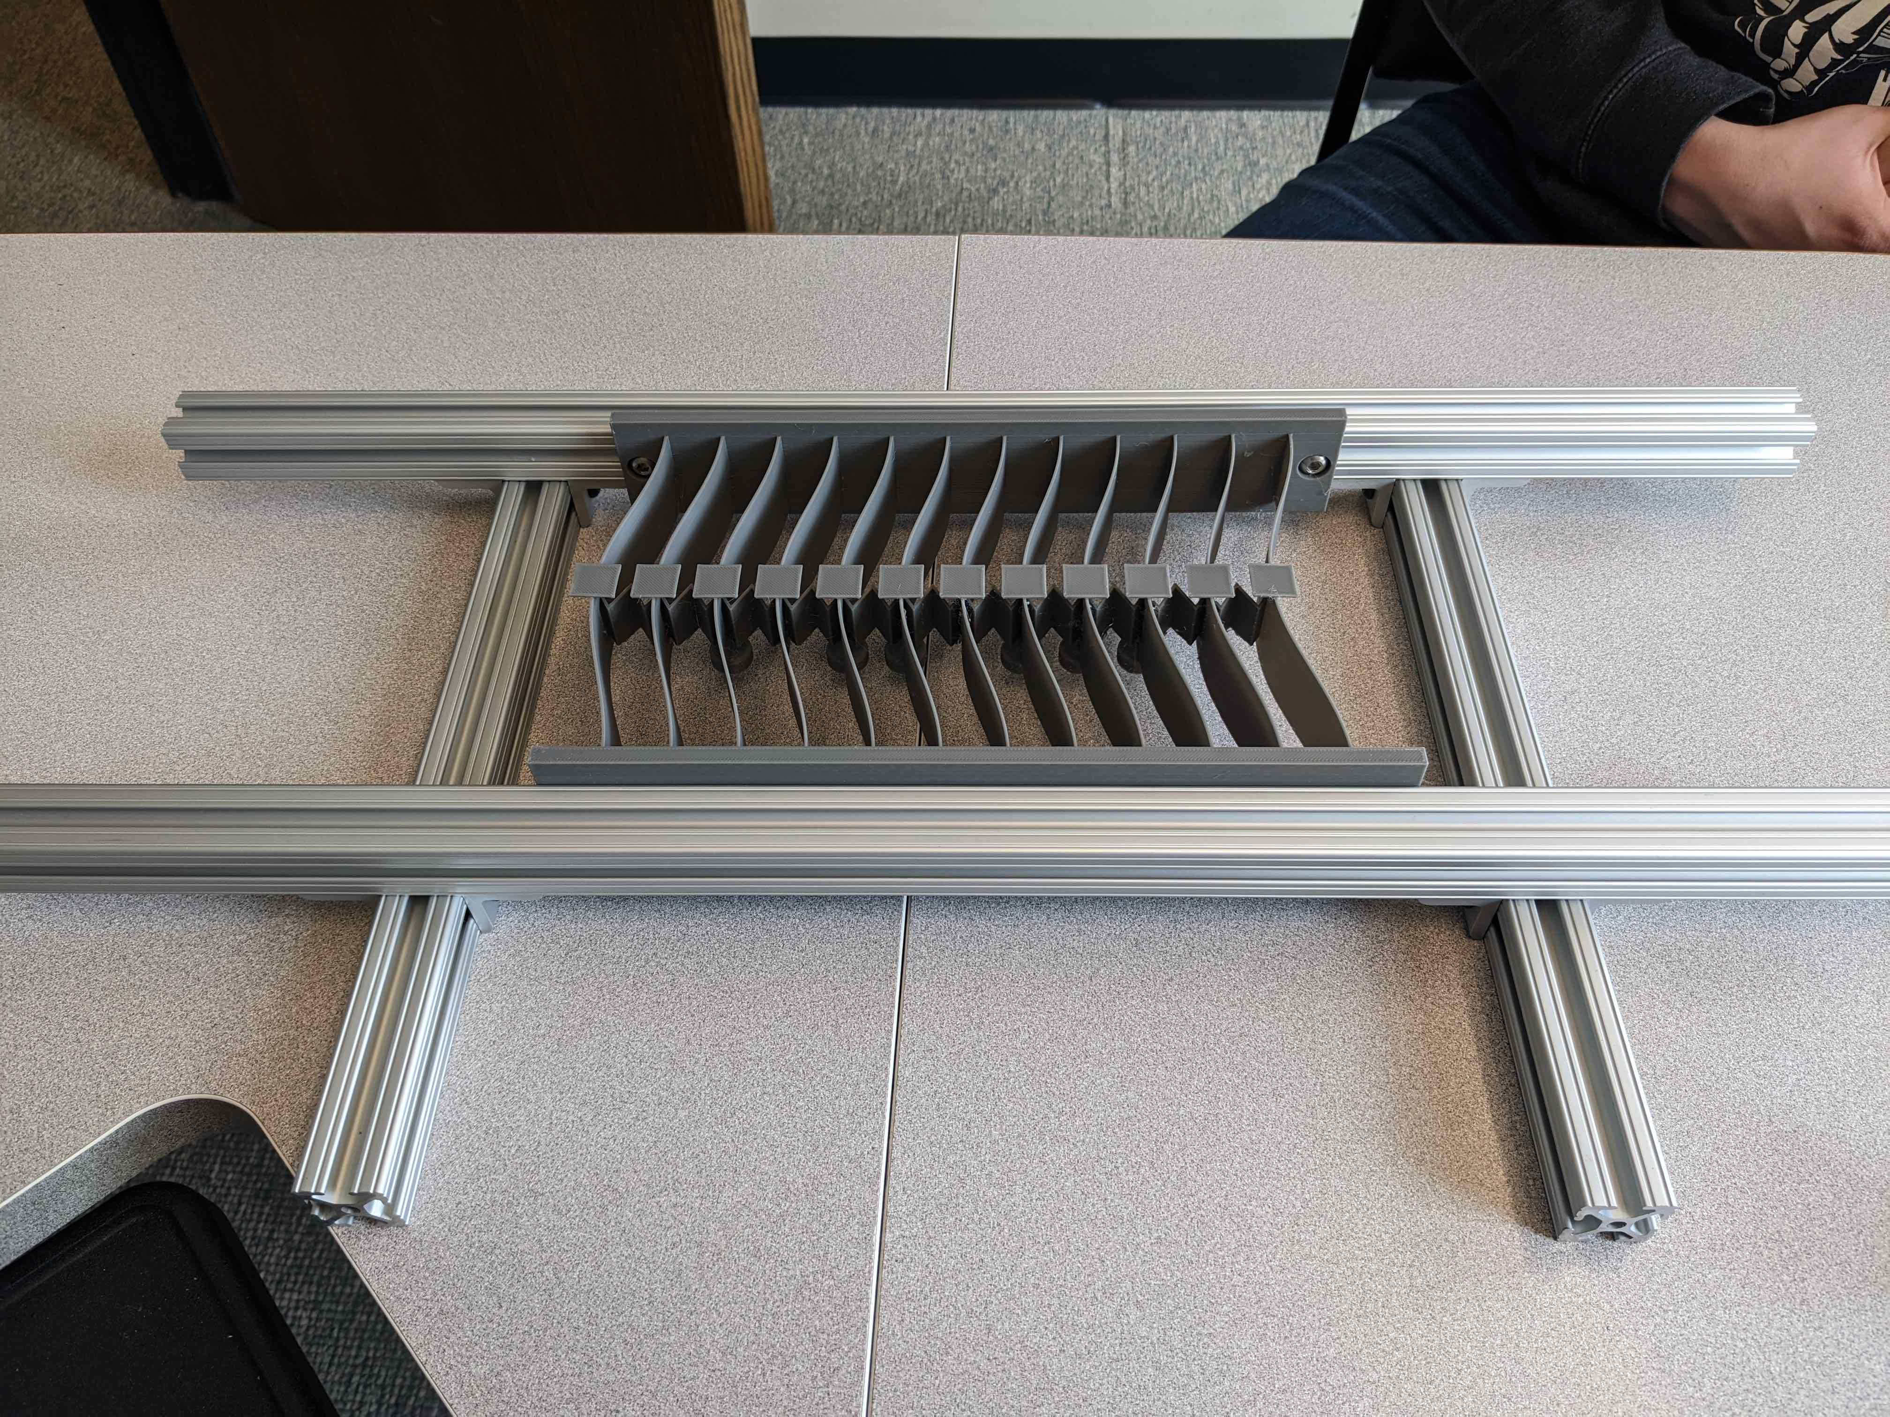
1D chain of bistable elements: Transition waves
Impulse
Input
Onsite bistable spring/mass elements (geometric nonlinearity)
Linear intersite springs
Supports propagation of nonlinear transition waves for all inputs above certain amplitude threshold
Nadkarni et. al., PRE 2014
Hwang and Arrieta, Smart Material Structures 2022, SPIE 2019, Scientific Reports 2018, PRE 2018

Slide 3
Introduction of a localized defect
Localized inhomogeneity in the onsite spring stiffness
Gives rise to localized oscillations (breather) near the defect
Energy transfer between the travelling wave and the local oscillations
Complicated (chaotic) dynamics due to this interaction
* Figotin and Klein: Journal of statistical Physics 1997, Fei et al., PRA 1992, Zhou et al., PRE 2017, Dauxois and Peyrard, 2006

Slide 4
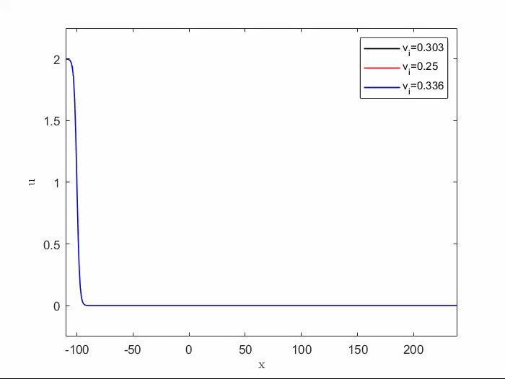
Wave transmission, capture and reflection
Displacement
Position
Defect location

Slide 5
Input-output velocity relation for the system with defect
Captured waves
Transmitted waves
Outgoing velocity
Reflected waves
Incoming velocity

Slide 6
Full-order Discrete Model and Continuum Approximation
Nondimensionalized N-DOF model :
for masses ,
with nonlinear potential
Continuum approximation (nonlinear wave equation)
* Nadkarni et. al., PRE 2014

Slide 7
Continuum approximations for the system with and without defect
Without Defect :
Transition (travelling) wave : moves with fixed speed below c
Dispersion relation (linearizing about 0 solution ):
Bandgap
Phonon spectrum, q = wavenumber
With Defect :
A time-periodic (linearized) mode localized in space appears : Breather
Breather (temporal) frequency lies in the bandgap
oscillatory

Slide 8
Low-order model of wave-breather interaction : Modes
Two-DOF low-order model with fixed shapes
DOFS: Solitary wave center position X(t) and amplitude of the breather a(t)
Ignoring energy transfer
To phonons due to discreteness effects (present in discrete model only)
To phonons due to wave-breather interaction (present in discrete and continuum models)
To the other bound mode (present in discrete and continuum models)
+
0
solitary wave
Breather

Slide 9
Low-order model : Method of collective coordinates
Standard method to obtain finite dim. governing equations from Lagrangian density
Extremize the Lagrangian among the fields represented by the ansatz
K.E.
Linear spring
P.E.
Nonlinear spring
P.E.
A conservative 2-DOF
system: Coupled oscillator
* Dauxois and Peyrard, 2006

Slide 10
Low-order model prediction : Input-Output Relation
Outgoing velocity
Incoming velocity

Slide 11
Low-order model prediction : Trajectory of the solitary wave
Transmitted waves
Captured waves
Interaction with the breather
Position of
Wave-front
Reflected waves

Slide 12
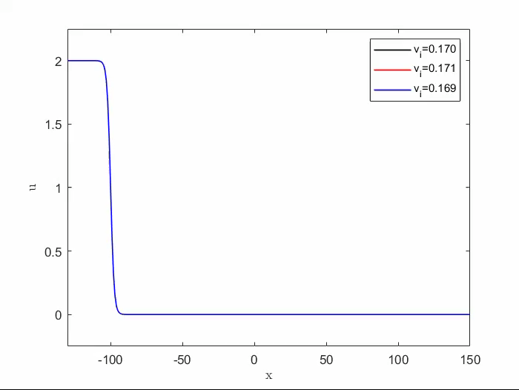
Wave transmission, capture and reflection : Reduced order model

Slide 13
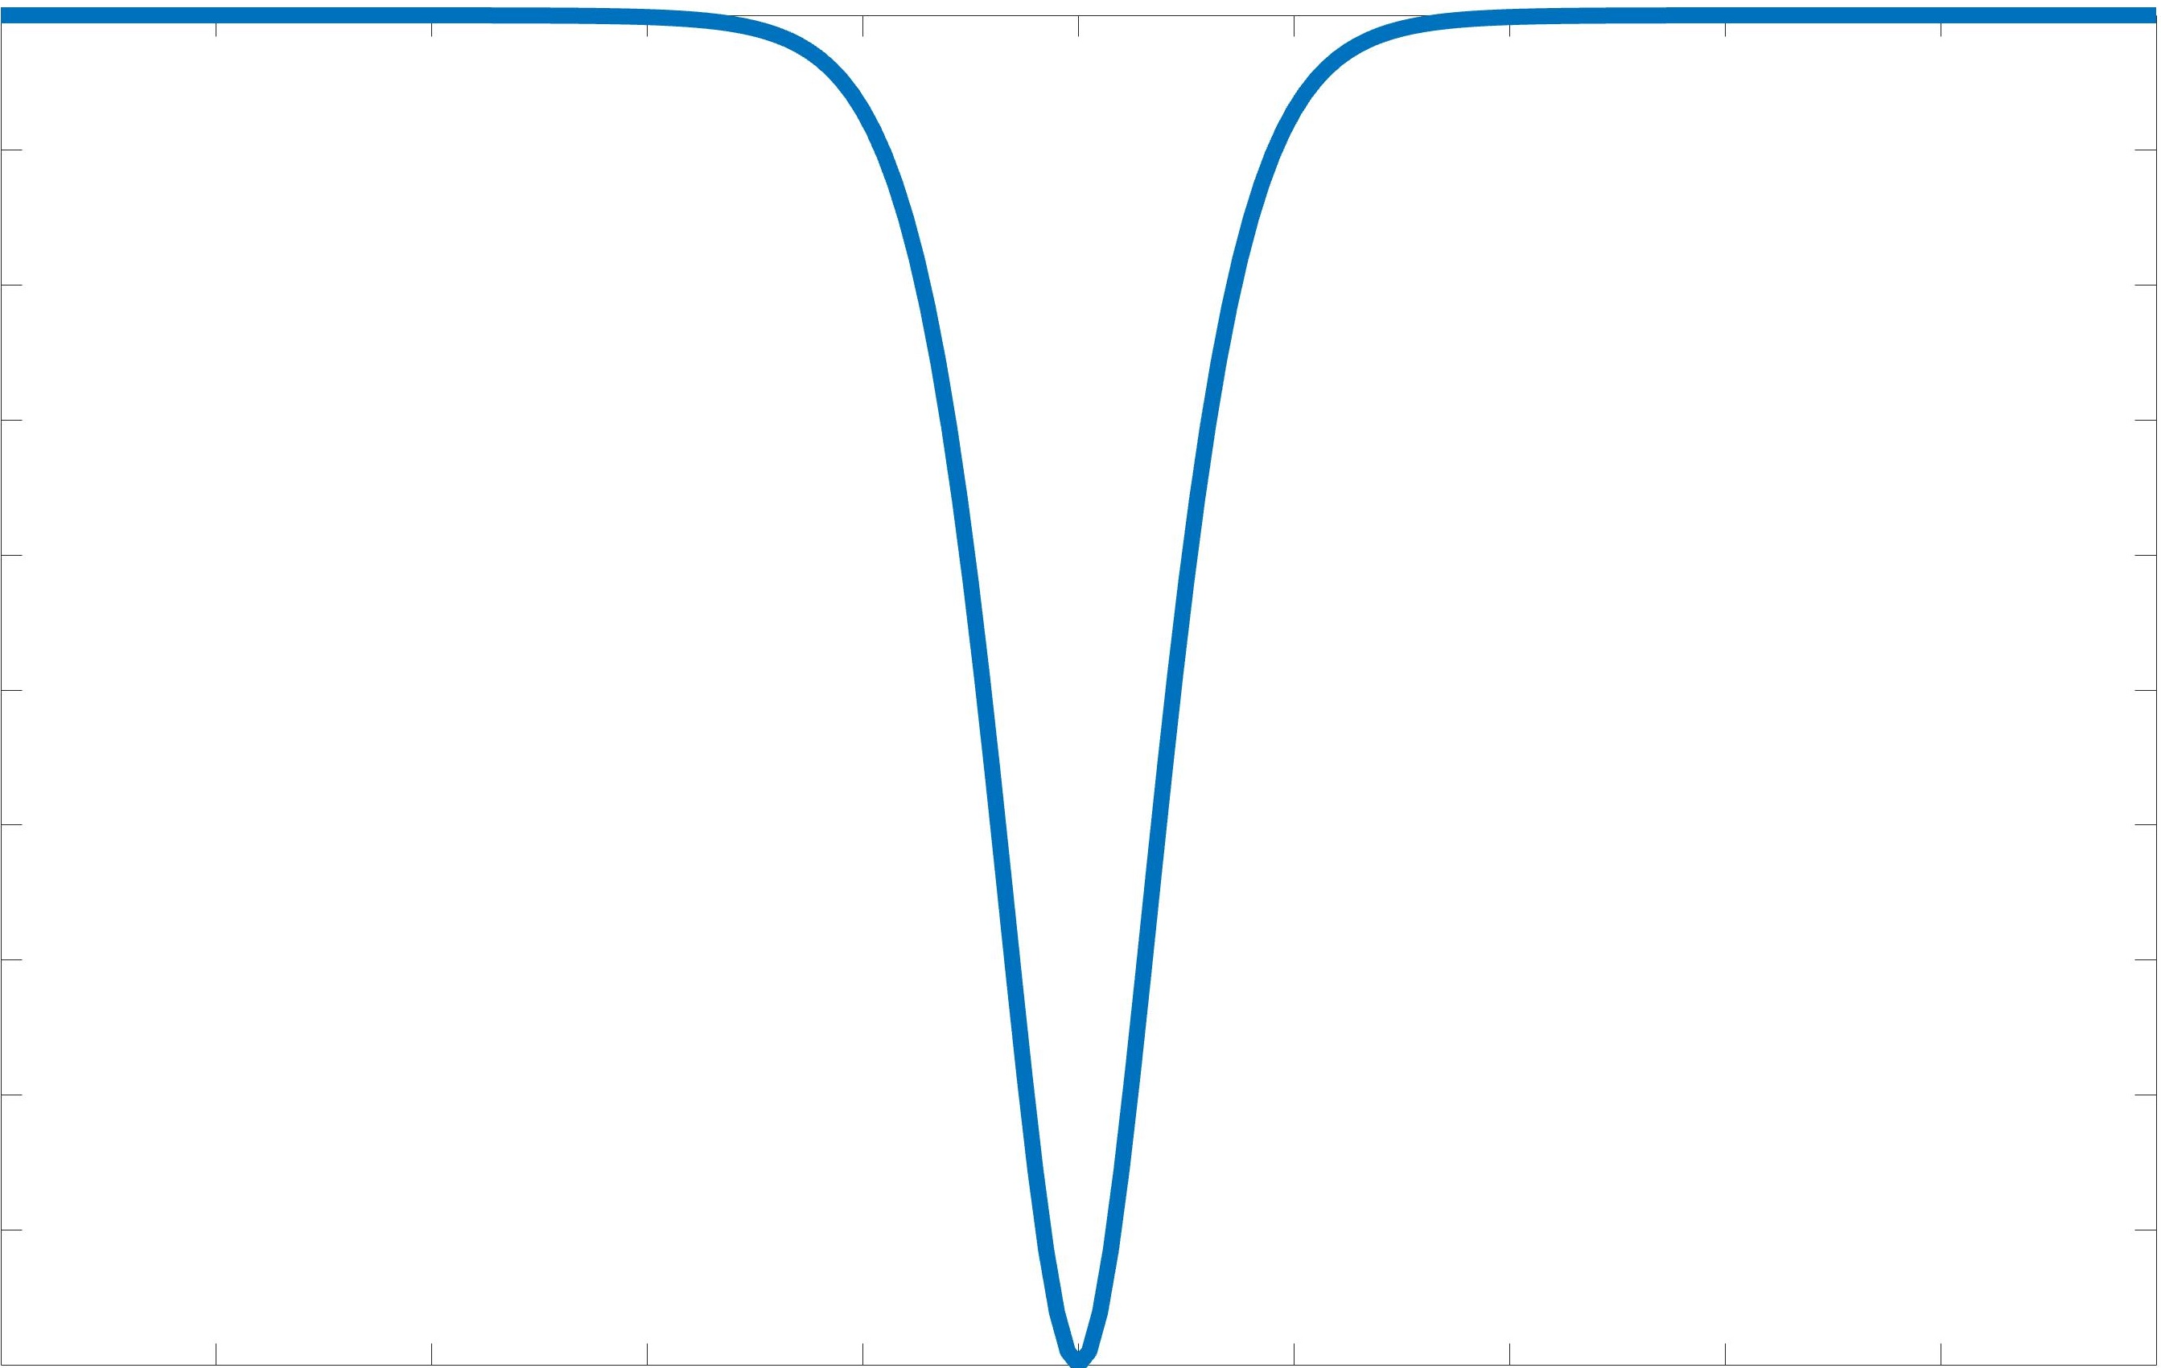
Low-order model : Phase space analysis
Step 1: Switch to Hamiltonian approach
Four-dimensional nonlinear Hamiltonian system
Step 2: Split the Hamiltonian in a specific way* and introduce an artificial coupling parameter
The breather dynamics are uncoupled from the solitary wave: Fully integrable system
The actual system is recovered
Heteroclinic orbit
0
-0.2
-0.1
0
0.1
0.2
Particle moving
in the potential well
1DOF Nonlinear oscillator
* Goodman et al., Physica D 2002

Slide 14
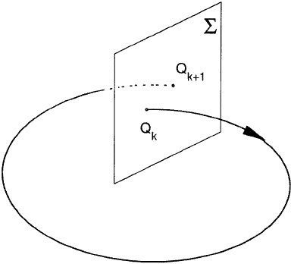
Phase space analysis:
The solitary wave and breather dynamics are fully-coupled in 4D: cannot study the dynamics in separate 2D phase plots
For small , the periodic orbits ( ) persist and can be used to define a Poincare map
Action-angle transformation
Near-integrable system
Poincare map P:
Fix the total energy level
Fix the phase of breather (say )
We obtain a discrete-time 2D dynamical system on the surface
Dynamics are constrained to 3D hypersurface

Slide 15
Periodic
Orbit at -
Periodic
Orbit at +
Unstable Manifold of
periodic orbit at -
Stable Manifold of
periodic orbit at +
*Koon et al., Chaos 2000

Slide 16
Phase space analysis for
: Lobe Dynamics
Stable and unstable manifolds of periodic orbits at infinities intersect transversally
Transport is possible between the three regions
*Wiggins, Chaotic Transport in Dynamical Systems, Springer 2013

Slide 17
Transmitted Wave: Lobe Dynamics

Slide 18
Reflected Wave: Lobe Dynamics

Slide 19
What determines the threshold for wave transmission across the defect ?
Critical energy= energy of the incoming wave with
(and no energy in breather)
Trajectory in the
gap avoids the lobes
Gap >0 above critical energy
Max. incoming wave speed,
no energy
in breather
Range of
allowable
incoming
wave speeds
Zero incoming
wave speed,
all energy
in breather
Flow with fixed total energy in breather + solitary wave

Slide 20
Ongoing work
Improved reduced-order models by incorporating energy leakage to phonons as a (nonlinear) damping term
Experimental validation using 3D printed models
Modulation of breather energy in open-loop or feedback manner to tailor nonlinear waves
Extensions to 2D lattices
Papers/Preprints/Videos
Dynamical Systems Lab: engineering.unl.edu/dsl
Email: Piyush.grover@unl.edu

Slide 22
for masses ,
with nonlinear potential
Dimensional:

