Slide 1
COE Online P&T System training
UNL College of Engineering
January 2024

Slide 2
Overview of COE Online P&T Training Session
Accessing the System
Navigating the System
After the Candidate Submits File

Slide 3
Accessing the System
Website: https://coe-promotenure.unl.edu
Log in with your My.UNL credentials, then complete and submit initial registration
After your unit head approves your request, you will receive an email confirmation that you are registered and can begin using the system
If you are off-campus, you must connect through VPN to vpn.nebraska.edu (see https://its.unl.edu/services/vpn/ )
Notes:
Two layers of security;
Unit leaders need to log in to approve.

Slide 4
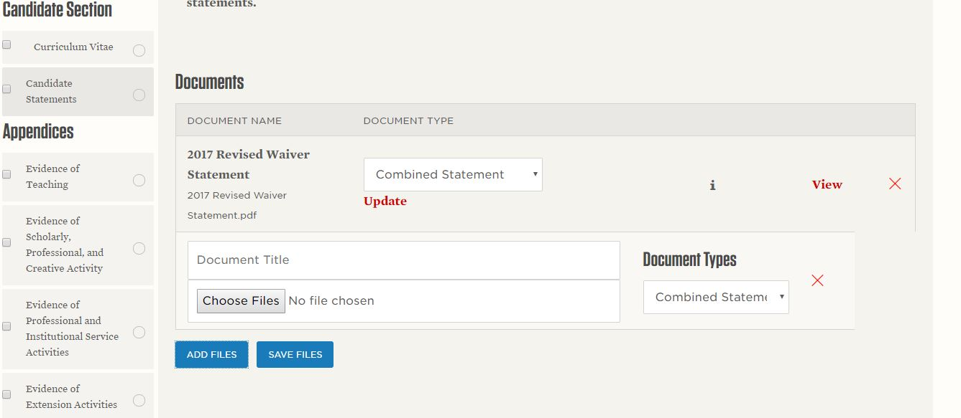
Navigating the System
Add documents to the assorted tab sections that apply to your appointment
In some sections, you are asked to specify what type of file it is~
Be sure to click blue button to ‘Save Files’ !
Notes:
It matches EVC’s documentation requirements nicely

Slide 5
Navigating the System
While you are ultimately responsible for the preparation of your dossier, your department/school may assist with preparing and/or uploading documents in the ‘Administrative Section’, while file is still at ‘Candidate’ level
Communicate with your unit head!
Docs that candidates cannot upload themselves include:
Transmittal Form
Waiver Form
Letters from Unit P&T, Chair, College P&T, Dean
External Review Letters
Notes:
Pdf format is required…
‘update’ is only updating the document type
External review letters are not seen by candidates in this system

Slide 6
Navigating the System
Appendices: uploaded to electronic system also
Creating PDFs of uploaded files
Candidate should submit ‘complete’ file to next level by the annual deadline
This year: Monday, August 18, 2024

Slide 7
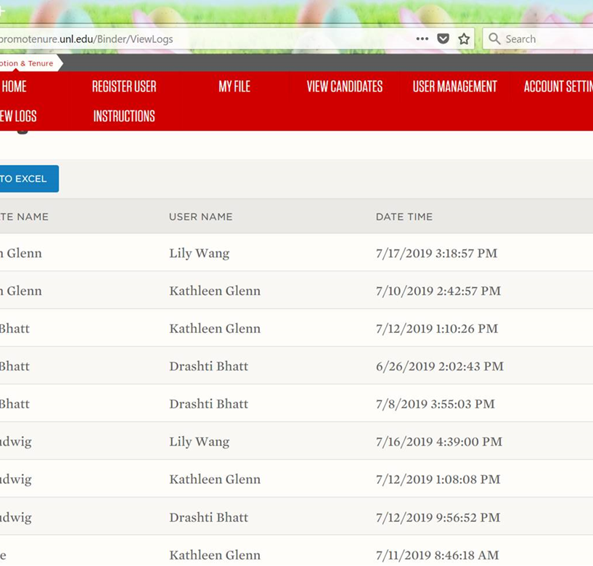
Navigating the System: Chairs Role
Manage Roles and Restrictions for their faculty and staff (‘Register User’, ‘User Management’)
‘View Logs’

Slide 8
After the Candidate Submits the File
Unit P&T Committee Chair or Unit Heads:
Upload documents to the External Review Letter Section
Upload Unit P&T or Chair Review Letters
When review is completed, move file forward to next level (from candidate’s File Status box)
Please do not delete any previously submitted/reviewed versions of the same file (e.g. when updating CVs, statements, etc.)
File deletions are being logged…
Notes:
Moving from one level to another…after that you lose the ability to upload files.

Slide 9
After the Candidate Submits the File
Candidates may request a copy of their P&T dossier documents throughout the process
they they may not themselves add documents after August 18
To add documents after August 18, candidates should submit them to the person in charge of the current review loop for that person to upload

Slide 10
If you have any questions or need further assistance, we are happy to help! Yusong Li(yli7@unl.edu) Associate Dean for Faculty and Inclusion Kathy Glenn (kglenn2@unl.edu) Director of Administration and Chief of Staff 114 Othmer, 402-472-7071

