Slide 1
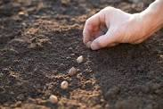
PLTW Launch: A Hands-On Experience
Debi Korell
NW RPDC, Maryville, Missouri
Korell@nwmissouri.edu
Notes:
Introduce self
Here to share with you some information of PLTW Launch … Oh Yeah!

Slide 2
WELCOME!
PLTW ________, __________, _________ students!
Fill in the blanks with verbs!
Notes:
To get us started, please take a post-in note and write in your thoughts for completing this statement…. Read slide
Share verbs at table
We will come back to this at the end of our hour

Slide 3
PLTW Launch
24 Modules
Kindergarten – 5th
4 modules per grade level
Notes:
PLTW has 24 modules, K-5, 4 modules per grade level

Slide 4
Per Grade Level Modules
(2) Engineering (E)
BioMed
Computer Science (CS)
Notes:
Speak to slide

Slide 5
Per Module
Frameworks/Standards
APB Instructional Model
Key Terms
Launch Logs
Balanced Assessments
Notes:
Each Module contains the following:
Address each and have participants look at examples in envelope on table
Frameworks: SC, CS, ELA, MA standards
Big Idea, Essential Questions
APB explain but will come back to
Key Terms – vocabulary introduced but taught in context of learning
Launch Logs – two (K-2 module specific), 3-5 generic --- great place to tie in ELA
Balanced Assessment – explain where formative and summative.

Slide 6
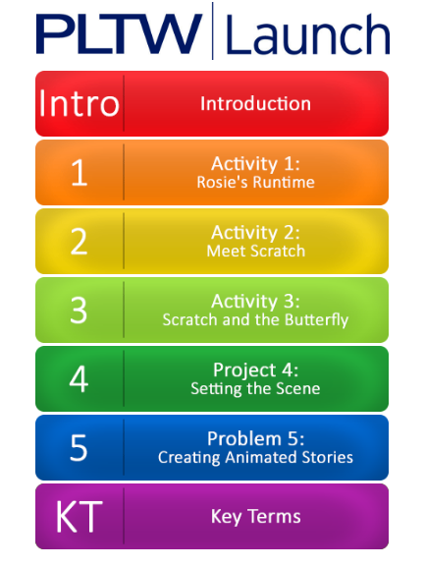
APB Model: Activity, Project, Problem
Notes:
The same instructional model is used within each module.
Each module begins with an introduction
Read introduction … what did you notice?
problem –same characters
Following the introduction, there are
3 activities --- which build the skills and knowledge of the module concept
a Project – where students apply these skills and knowledge
a Problem…. Where students work through the problem that was stated at the beginning of the module
The module is very student centered and
This structure empowers students to continue on and take ownership

Slide 7
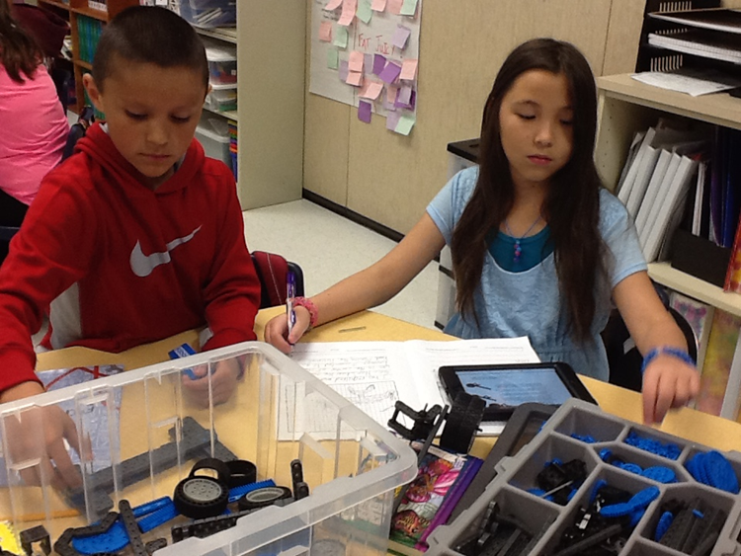
TO KNOW PLTW LAUNCH
Is to experience pltw launch

Slide 8
Computer Science: Animated Storytelling
Introduction
Notes:
Explain that we will be experiencing a 1st grade Computer Science module titled Animated storytelling/
Tie in ELA standards and predict what you may study
Introduce vocabulary

Slide 9
Questions to Ponder …
How does this activity tie into Computer Science?
What type(s) of thinking/skills do students need to use/do?
How can this activity be differentiated for students?
How could this activity be applied to a real-world situation at your school?
Notes:
Think of these four questions as you work through the activity
When your team has finished the activity, discuss these questions

Slide 10
Launch Log

Slide 11
Activity 1: Rosie’s Runtime
Notes:
Give overview of activity:
Rosie the robot dog wants to get her bones and bring them back to her doghouse, but she can’t get her paws dirty!
Use Rosie code cards to make up a program for Rosie to follow to get to her bones and then go to her doghouse.
Remember to jump over mud puddles!
Directions are on the table

Slide 12
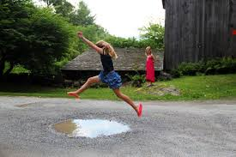
Code Cards
Move forward
Turn left
Turn right
Jump over
Take bone
Notes:
Demonstrate each

Slide 13
Rosie’s Runtime
RULES
Rosie must land on a bone before she can pick it up.
Rosie has to land on her doghouse to finish the game.
Rosie CANNOT jump over a mud puddle if it would make her fall off the game board.

Slide 14
Rosie’s Runtime: Let’s Begin

Slide 15
Questions to Ponder … Debrief
How does this activity tie into Computer Science?
Other standards?
What type(s) of thinking/skills do students need to use/do?
How can this activity be differentiated for students?
How could this activity be applied to a
real-world situation at your school?
Notes:
Unplugged activity; precursor for computer programming
Critical thinking, 21st century skills
Placement of objects

Slide 16
Activity 2: Meet Scratch
Notes:
Ipads on table
Explain this activity

Slide 17
APB Model: Activity, Project, Problem
Notes:
Give brief overview of Activity 3, Project and Problem

Slide 18
Computer Science: Animated Storytelling
Key terms
Check for understanding

Slide 19
Notes:
Project Lead the Way Summit 2016: Inspire, Engage, Empower

Slide 20
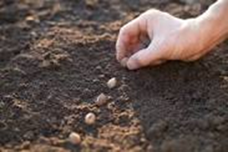
PLTW
INSPIRES,
ENGAGES,
EMPOWERS
students!

Slide 21
THANK YOU!
Debi Korell
Korell@nwmissouri.edu

