Slide 1
Burnout & Self-Care
Mandy Hansen, LIMHP
Counseling and Psychological Services (CAPS)

Slide 2
OBJECTIVES
Participants will demonstrate an understanding of workplace burnout, its causes, and at least 3 signs/symptoms of it.
Participants will be able to identify the multiple dimensions of well-being & self-care
Participants will gain insight in to their own self-care practices and demonstrate understanding of how to create and implement a self-care plan

Slide 3
WORLD HEALTH ORGANIZATION
Burn-out is included in the 11th Revision of the International Classification of Diseases (ICD-11) as an occupational phenomenon. It is not classified as a medical condition.
It is described in the chapter: ‘Factors influencing health status or contact with health services’ – which includes reasons for which people contact health services but that are not classed as illnesses or health conditions

Slide 4
WORLD HEALTH ORGANIZATION cont’d.
“Burn-out is a syndrome conceptualized as resulting from chronic workplace stress that has not been successfully managed. It is characterized by three dimensions:
feelings of energy depletion or exhaustion
increased mental distance from one’s job, or feelings of negativism or cynicism related to one's job
reduced professional efficacy.
Burn-out refers specifically to phenomena in the occupational context and should not be applied to describe experiences in other areas of life.”

Slide 5
COMMON CAUSES
Lack of control
Unclear job expectations
Dysfunctional workplace dynamics
Extremes of activity
Lack of social support
Work-life imbalance
Notes:
1) An inability to influence decisions that affect your job — such as your schedule, assignments or workload — could lead to job burnout. So could a lack of the resources you need to do your work.
2) If you're unclear about the degree of authority you have or what your supervisor or others expect from you, you're not likely to feel comfortable at work.
3) Perhaps you work with an office bully, or you feel undermined by colleagues or your boss micromanages your work. This can contribute to job stress.
4) When a job is monotonous or chaotic, you need constant energy to remain focused — which can lead to fatigue and job burnout.
5) If you feel isolated at work and in your personal life, you might feel more stressed.
6) If your work takes up so much of your time and effort that you don't have the energy to spend time with your family and friends, you might burn out quickly.

Slide 6
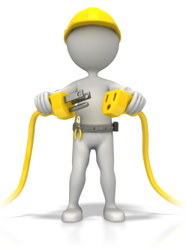
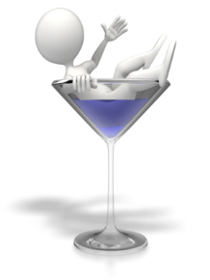
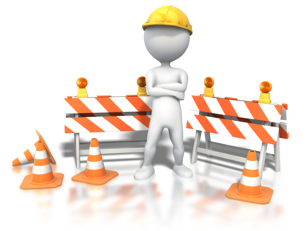
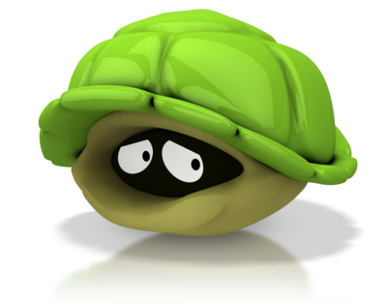
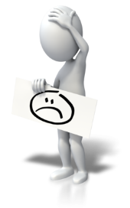
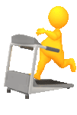
WARNING SIGNS
Illness
Chronic Exhaustion
Detachment
Isolation
Poor Boundaries
Cynicism
Survival Coping
Loss of Productivity
Avoidance
Anger
Diminished Self-Care
Notes:
(Click the remote or press the space bar). Chronic exhaustion –You find yourself lacking energy and feeling tired often. You may go to bed early but still wake up tired. You may move more slowly and find you need extra time to get ready and get out the door. At its worse, the fatigue becomes a physical and psychological state of exhaustion. You feel drained. Everything takes a concerted effort. You have no energy, so you do as little as possible to make it through the day. You find it difficult to get out of bed and may even call in sick on the days you feel like you simply can't get out of bed. This type of extreme fatigue also often results in a sense of dread for what lies ahead of you on any given day.
(Click the remote or press the space bar). Isolation– Isolation may start out as a mild resistance to socializing, such as not wanting to go to lunch with a co-worker or friend. As burnout worsens, you may begin to feel more and more like being alone. Colleagues dropping by to say hello may become an annoyance, and you may find yourself closing your door to keep people out. You make excuses not to go out to lunch, or you search for ways to get out of meetings. In the most severe cases, you may get angry at people who approach you. You may even lock your door to keep people away, or come in early or leave late to avoid interactions with colleagues and possibly even family members.
(Click the remote or press the space bar). Detachment– You feel so overwhelmed that you shut down. A general sense of feeling disconnected from others and from your environment. This can take the form of the isolative behaviors described above. In some situations, it may come across as anger toward others. But it also can take the form of detaching yourself emotionally and physically from your job and your responsibilities. For example, you may start calling in sick more often, missing appointments, being chronically late, or not returning calls or emails
(Click the remote or press the space bar). Loss of productivity - Despite long work hours, the symptoms of burnout prevent you from being able to produce the way you used to, which results in incomplete projects and a stack of work that just keeps piling up. It often seems like the harder you work, the more ground you lose. And try as you might, you just can't climb out from underneath the pile.
(Click the remote or press the space bar). Avoidance -the phone rings or your pager goes off and you think “I'm not answering it.” You see your message light beeping and you ignore it. Your alarm clock goes off and you think of all the reasons you can’t go in that day. You may have a sense of dread that you will be faced with more bad news or horrible experiences. You fear that you will be met at the door with big problems and no solutions.
(Click the remote or press the space bar). Boundaries – you compensate by switching into what you believe is high gear. You spend more time at work, take more work home, give up outside work activities to get to work earlier and then leave later. You make executive decisions that may intrude on the desires of others because you believe that’s more efficient than asking someone’s opinion. You take it personally when a project fails.
(Click the remote or press the space bar). Anger – Because burnout victims often feel like a failure and experience a lot of guilt, it's not uncommon for these feelings to turn into anger and resentment as the stress continues, and you feel as if you have no control over it. At first, the anger may take the form of interpersonal tension with colleagues, family, or friends. As burnout becomes more severe, the anger may intensify and result in angry outbursts and serious arguments at home and in the workplace. You may have thoughts of violence toward coworkers or family, and at its most extreme, this may cross the line into actual violence. When the anger gets to the point where you start thinking of hurting someone else, or you cross the line and actually get into a physical altercation, seek professional assistance immediately to prevent anyone from getting hurt, including you.
(Click the remote or press the space bar). Cynicism - Burnout makes you feel like nothing is going to turn out well. While at one time, you may have been a person who sees the "glass half full," burnout may cause you to feel as if the "glass is half empty," or in some cases, completely empty. This type of negativity is likely to result in negative "self-talk," such as feelings of worthlessness and hopelessness. It also may carry over to others, feeling as if no one cares or that everyone is out for themselves. This may lead to a lack of trust toward coworkers, family, and friends, increasing tension at home and in the workplace and separating you from social support sources that may once have served as a buffer to your stress.
(Click the remote or press the space bar). Diminished Self-Care - you or your friends and family begin to notice that you are not doing what you used to do to take care of yourself. You may be less concerned about your appearance or exercising.
(Click the remote or press the space bar). Illness – you may begin to experience pain or illnesses. Your body is telling you that it is overwhelmed. Remember that an excess of stress hormones over time can affect your immune system.
(Click the remote or press the space bar). Survival Coping- instead of going to that happy hour once a week it becomes a daily ritual on the way home.

Slide 7
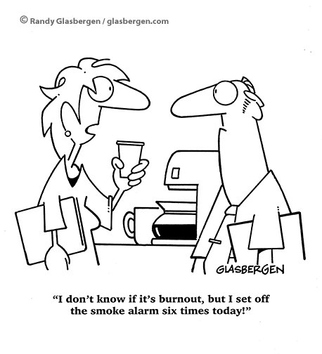
Top 10 signs you’re too stressed
You’re so tired you now answer the phone, “Hell.”
Starbucks is listed as your emergency contact.
You wake up to discover your bed is on fire, but go back to sleep because you just don’t care.
You have so much on your mind, you forget to go to the bathroom unless it’s on your schedule.
You need a vacation so badly, you’ve contemplated plotting your own kidnapping.
You consider Red Bull part of a balanced diet.
Your muscles are so tense, you’re convinced you were the Tin Man in a previous life.
Your partner threatens to throw your iPhone out the window after you answer a work call or email for the tenth time during your date.
Your best friends think you have moved away because they have not heard from you in so long.
You fall asleep during trips to the dentist’s office because it’s the only time you put your feet up.

Slide 8
Steps to Stress Reduction: Address Workplace Concerns
Evaluate your options.
Seek support.
Try to find some value in your work.
Make friends at work.
Take time off.
Set boundaries.
Take a daily break from technology.
Notes:
Discuss specific concerns with your supervisor. Maybe you can work together to change expectations or reach compromises or solutions. Try to set goals for what must get done and what can wait.
Whether you reach out to co-workers or your supervisor, support and collaboration might help you cope. If you have access to an employee assistance program, take advantage of relevant services.
Even in some mundane jobs, you can often focus on how your role helps others, for example, or provides a much-needed product or service. Focus on aspects of the job that you do enjoy, even if it’s just chatting with your coworkers at lunch. Changing your attitude towards your job can help you regain a sense of purpose and control.
Having strong ties in the workplace can help reduce monotony and counter the effects of burnout. Having friends to chat and joke with during the day can help relieve stress from an unfulfilling or demanding job, improve your job performance, or simply get you through a rough day.
If burnout seems inevitable, try to take a complete break from work. Go on vacation, use up your sick days, ask for a temporary leave-of-absence, anything to remove yourself from the situation. Use the time away to recharge your batteries and pursue other methods of recovery
Don’t overextend yourself. Learn how to say “no” to requests on your time. If you find this difficult, remind yourself that saying “no” allows you to say “yes” to the commitments you want to make.
Set a time each day when you completely disconnect. Put away your laptop, turn off your phone, and stop checking email.

Slide 9
Steps to Stress Reduction: Engage in Self -Care
Self-care is the practice of taking an active role in protecting one's own well-being and happiness, in particular during periods of stress.
Notes:
Self-care is:
only taking responsibility for job functions you have control over.
the ability to maintain a positive attitude towards the work despite challenges.
the staff person’s right to be well, safe, and fulfilled.

Slide 10
Self-Care: The ABCs
Awareness
Balance
Commitment

Slide 11
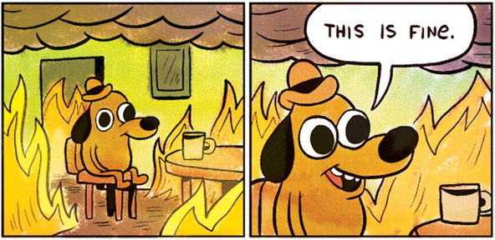
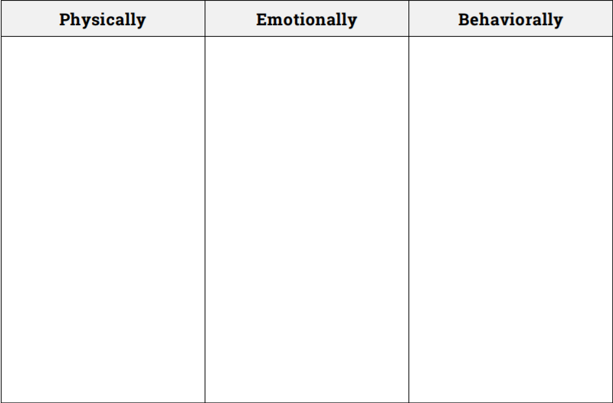
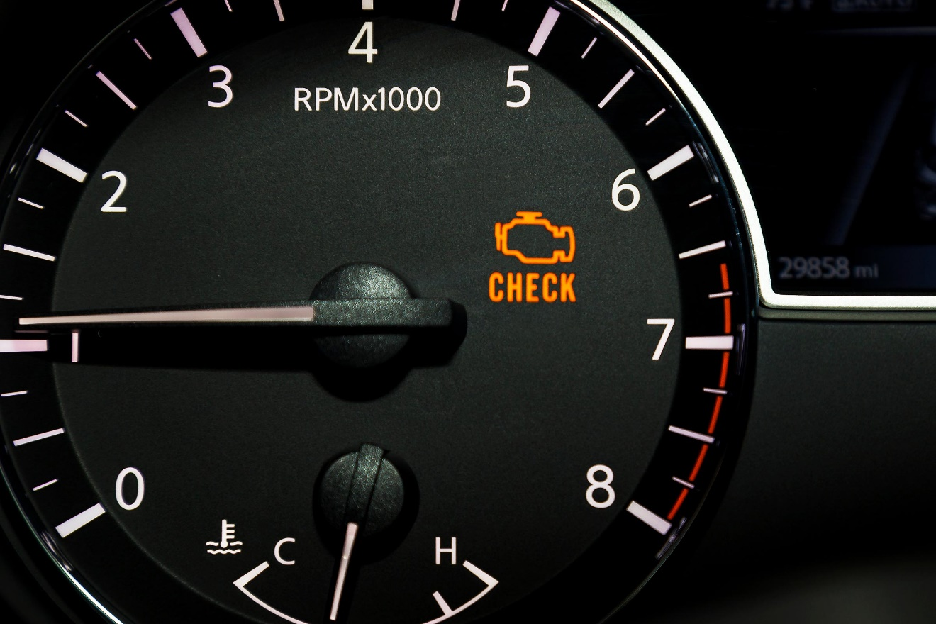
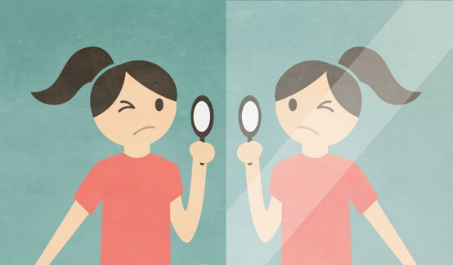
Self-Care: The ABCs Awareness
Notes:
The first step in self-care is much like the first step a clinician, physician, or mechanic takes in diagnosing a problem. It involves a check-up of your body and mind. You are the only person who can take this first step because everyone’s evaluation of stress and personal functioning is different. This step requires you to slow down enough and focus inwardly enough to determine how you are feeling, what your stress level is, what types of thoughts are going through your head, and whether your behaviors and actions are consistent with the who you want to be.
ACTIVITY: Recognizing Stress
List the ways you experience stress in the corresponding categories
Circle the ways stress affects you that are most troubling
Of each item you circled, how many days per week do you experience that?

Slide 12
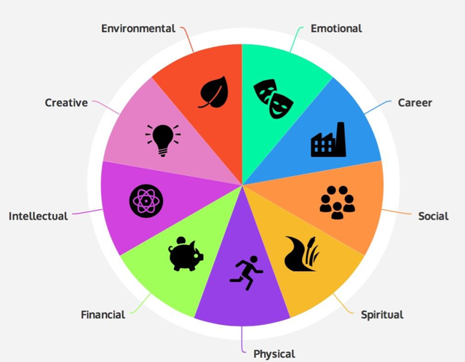
Self-Care: The ABCs Balance
3 = I do this well (e.g., frequently)
2 = I do this OK (e.g., occasionally)
1 = I barely or rarely do this
0 = I never do this
? = This never occurred to me
Notes:
The second step is to seek balance among a number of different types of activities. These include work, personal and family life, rest, and leisure. You will be more productive when you’ve had opportunities to rest and relax. What helps you relax may be very different from what relaxes your family members and colleagues. It’s important that the ways you relax aren’t damaging to your health and well-being (i.e., survival coping strategies) or to the relationships that are important to you. Becoming aware of when you are losing balance in your life gives you an opportunity to change.
ACTIVITY: Self-Care Assessment
Total scores:
0-62: Poor
63-125: Fair
126-188: Good
189-249: Excellent

Slide 13
Self-Care: The ABCs Commitment
1. Create it
Questions to ask yourself:
What helps me feel most at peace?
What brings me joy?
What brings me a sense of purpose?
Where do I find meaning and value in my life?
Formats:
List
Journal
Art
Anything you like!!!
2. Share it
3. Follow it
Helpful apps: Habitica (iOS & Google Play), Aloe Bud (iOS), Habit Tracker (Google Play)
Notes:
Effective self-care requires good planning and should be PROACTIVE, not REACTIVE. Self-care is not an emergency response plan to be activated when stress becomes overwhelming.
Self-care is NOT about acting selfishly (“It’s all about me!”).
Self-care is NOT about doing more or adding more tasks to an already overwhelming “to-do” list.
Healthy self-care can renew our spirits and help us become more resilient.
Create a self-care plan and then COMMIT to following it.
Make sure it addresses dimensions where you tend to struggle more.
Share it with others who will hold you accountable to it (SO, family, friends, mentor, etc.).

Slide 14
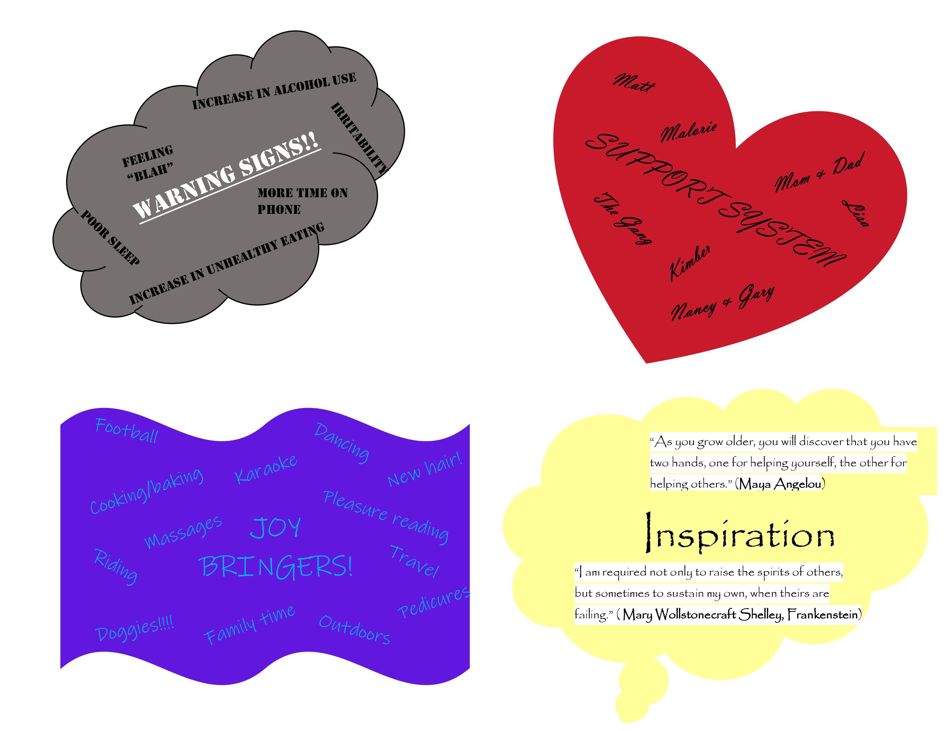

Slide 15
Steps to Stress Reduction: Seek Professional Help
When?
Changes in work setting have no impact
Self-care plan no longer working
Significant impairments in functioning
Where?
Company EAP
Community-based mental health provider
Agencies for un- & under-insured

Slide 16
REFERENCES
Marrow, M., Benamati, J., Decker, K., Griffin, D., & Lott, D. (2012, September). Think Trauma: A Training for Staff in Juvenile Justice Residential Settings. Retrieved April 10, 2018, from https://www.nctsn.org/resources/think-trauma-training-staff-juvenile-justice-residential-settings
Mayo Clinic. (2018, 21 November). Job burnout: How to spot it and take action. Retrieved August 6, 2019 from https://www.mayoclinic.org/healthy-lifestyle/adult-health/in-depth/burnout/art-20046642
World Health Organization. (2019, 28 May). Burn-out an "occupational phenomenon": International Classification of Diseases. Retrieved August 6, 2019 from https://www.who.int/mental_health/evidence/burn-out/en/
Notes:
Slide 31 Facilitator Notes:
For Your Eyes Only:
When the slide appears you will only see the title
Say:
The final letter is C for connection. It involves building connections and supportive relationships with your co-workers, friends, family and community. One of the most powerful stress reducers is social connection. Unfortunately, as we become more stressed we tend to avoid social connection especially when our minds tell us “everyone wants something from me.” We have to hear that thought, learn to set good boundaries, and reach out in new ways for connection.
Remember to think about ways you can reconnect with family members.
(Click the remote or press the space bar) Take your child’s suggestion about family game night or nightly reading seriously.
(Click the remote or press the space bar) Hear your partner’s repeated request to schedule a standing date night.
(Click the remote or press the space bar) Take up your friend on her offer to go and see a relaxing movie.
I am sure you all could come up with a million more. Now get out there and reconnect (click the remote or press the space bar).

