Slide 1








Ultra power micro-electromechanical systems (MEMS) computing hardware for edge AI applications
Fadi Alsaleem

Slide 2




Acknowledgment
Prof. Siavash Pourkamali
Nikfarjam, Hamed
Amin Abbasalipou
Prof. Roozbeh Jafari (Texas A&M)
Muhammad Emad-Ud-Din
Dr. David Lin (GE Research)
Dr. Sara Myers (University of Nebraska at Omaha)
Dr. Pipinos from the (University of Nebraska Medical Center)

Slide 3
Research Goals
To vertically advance the fields of novel integrated sensing and computing hardware technologies and artificial intelligence algorithms and their use in many health and medical applications.

Slide 4
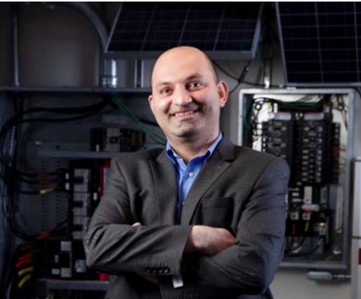
Quick Summary
Prof. Fadi Alsaleem
An associate professor, College of Engineering at the University of Nebraska at Lincoln
An adjunct research associate professor, Department of Biomechanics at the University of Nebraska at Omaha
An adjunct faculty, the graduate Data Science program at Bellevue University.
Six years in the industry, including four years as a Senior Lead Algorithm Engineer at Emerson Electric Inc. to develop novel (cloud-based) sensor monitoring and learning algorithms for fault diagnostics for HVAC systems
Have more than 10 awarded patents, more than 100 publications, presentations, invited talks, and over 6.5 million in funding from federal funding agencies such as NSF, DOE, and IARPA.
The recipient of the 2022 UNL College of Engineering Faculty Research and Creative Activity Award, the highest research award in the college, and is only given to one faculty per rank per year.

Slide 5


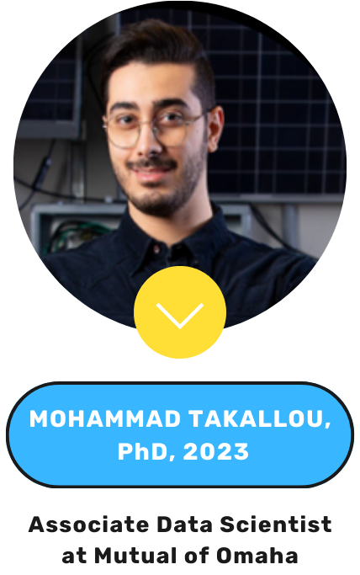

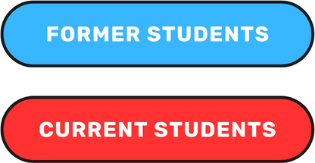

Research Group

Slide 6

Internet of Things (IoT) Age
175 Zettabyte of data (x10²¹) are generated in 2025 by IoT
Over 16.4 billion devices are connected to IoT
IoT is around $1.0 Trillion
Los Angeles Times

Slide 7
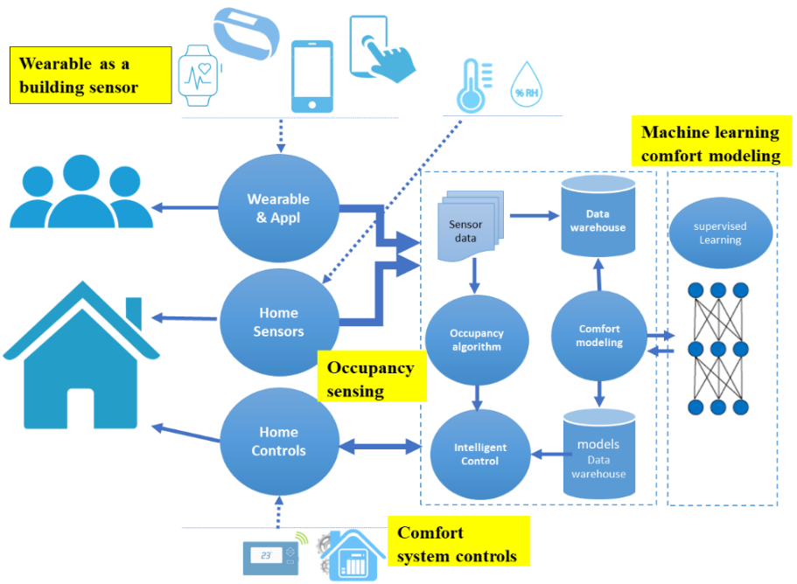
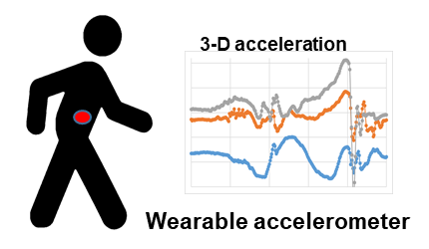
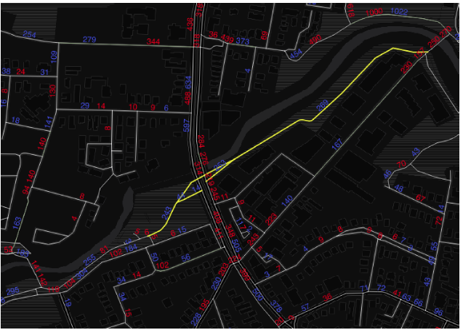
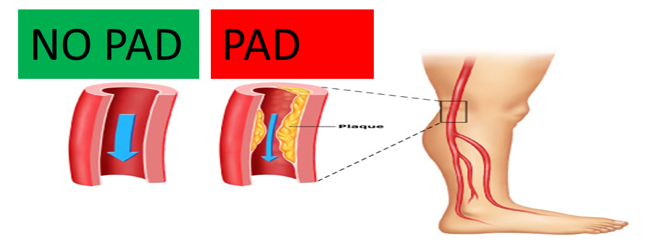


My IoT Related Projects
Peripheral artery disease
Wearable device to control comfort in building
Wearable device to diagnose diseases affecting gait
Wearable device to predict bicycle accident

Slide 8
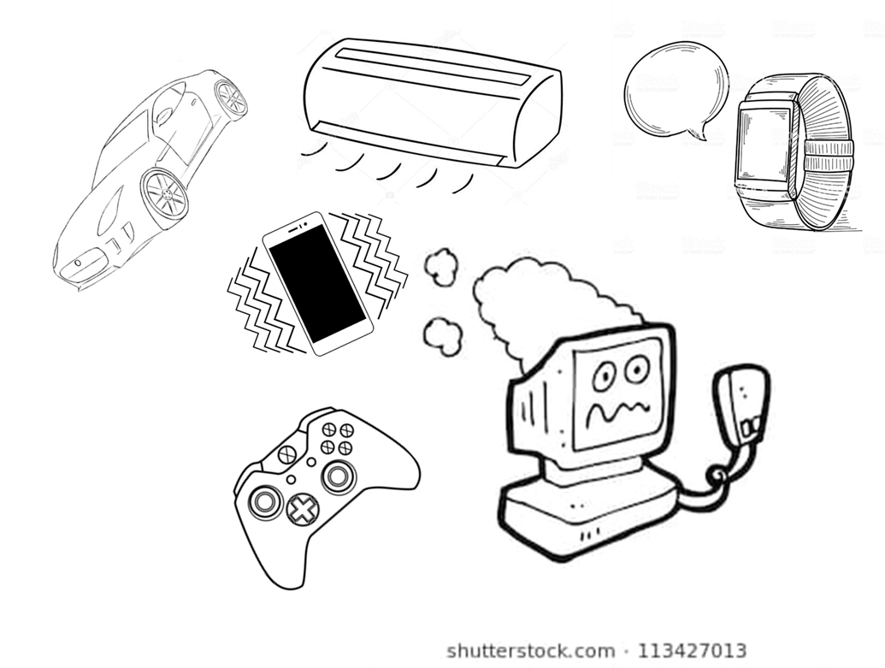
But, Are We Reaching IoT Too Quickly?
We are approaching the limits of classical computing
Require cheap sensors, communication devices, and computational units to be economically viable.

Slide 9
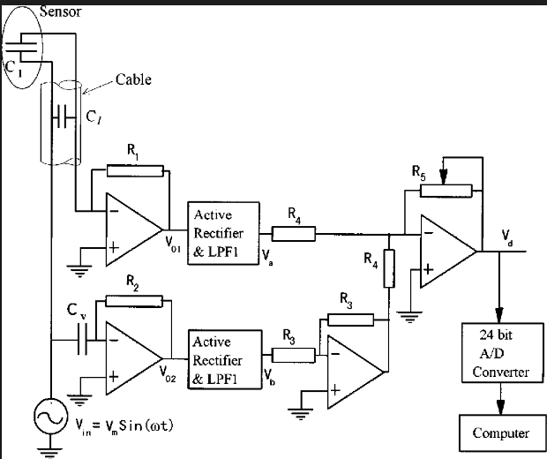
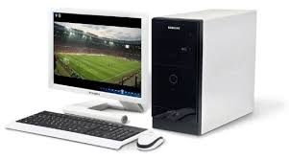
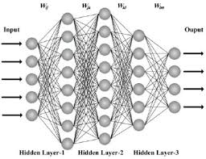
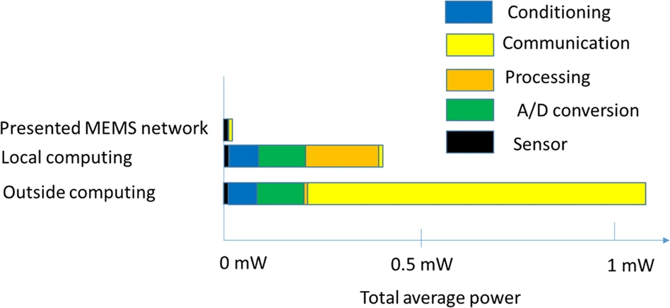
Intelligent Systems Are Too Complex
Environment
Conventional intelligent systems consist of sensors, complex sensor interfaces, and high computing power
Sensor
Sensor
Sensor
Sensor interface
Digital computers
Actuator

Slide 10
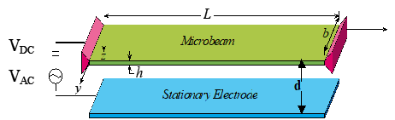
MEMS Is The Solution!
  Small size
  Low power
  Fast response time
  High bandwidth
C = εA/d
Parallel-plate capacitor that depends on the separation between two electrodes
The upper electrode is biased by a DC and AC voltages and can move due to the influence of the environment (i.e. temperature, pressure).
Thus producing a capacitive (voltage) change that correlates to the measurement of interest.

Slide 11
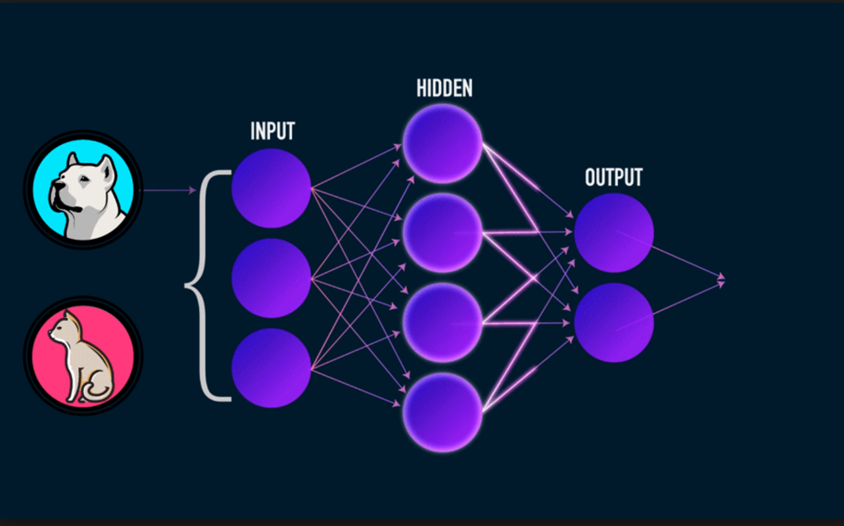
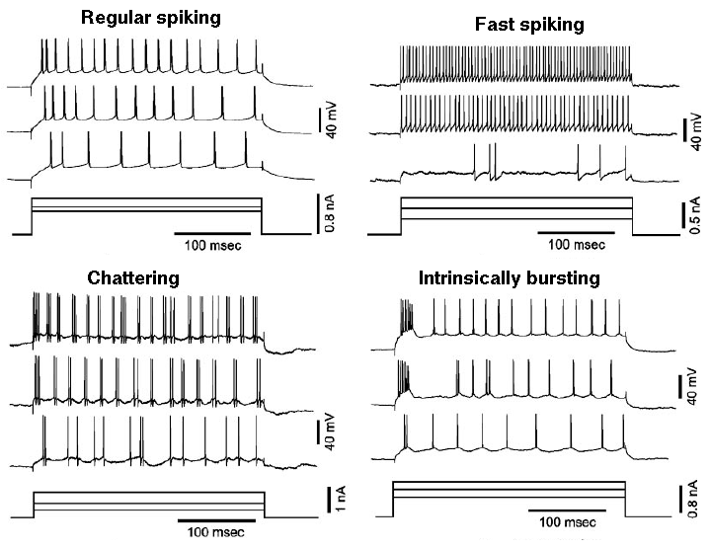
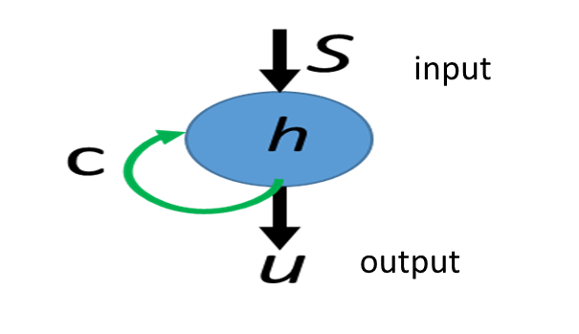
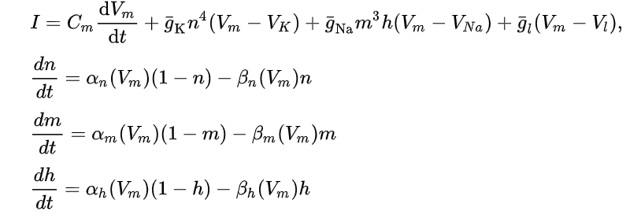

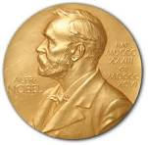

MEMS Neural Network
Spiking Neuron
Hodgkin and Huxley model
Sigmoid function
Typical machine learning ignores the time temporal effect
The Nobel Prize 1963
$$y\left(t\right)=I+wσ$$

Slide 12
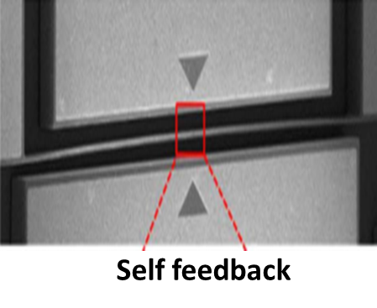
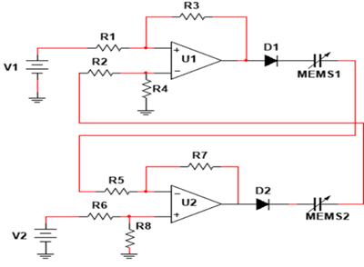
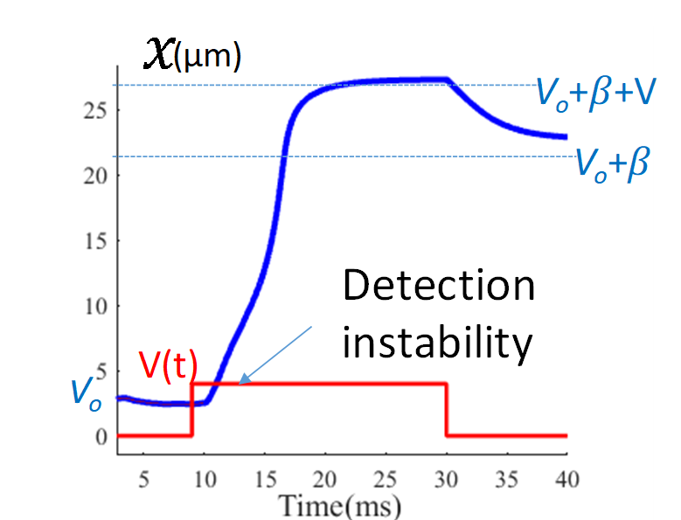
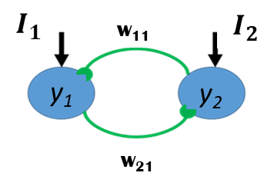
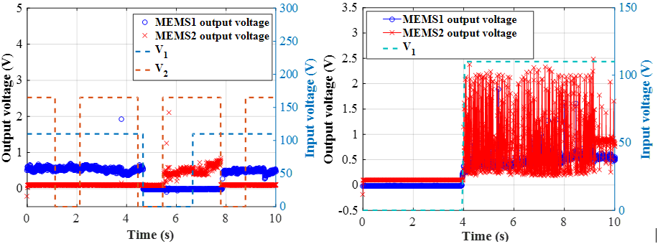
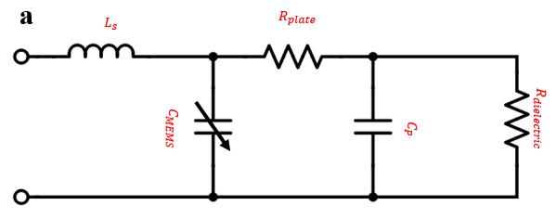
From Biology to MEMS!
Memory
Curvature
Switching: If one MEMS device is activated, the other device is attenuated
Oscillatory: perpetual motion under DC input
Detection
Electrical resonance

Slide 13
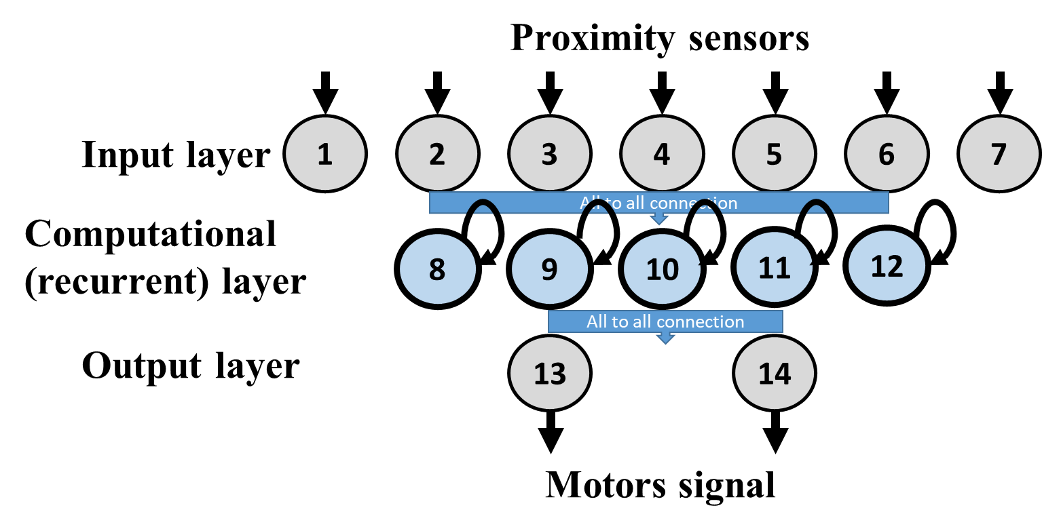
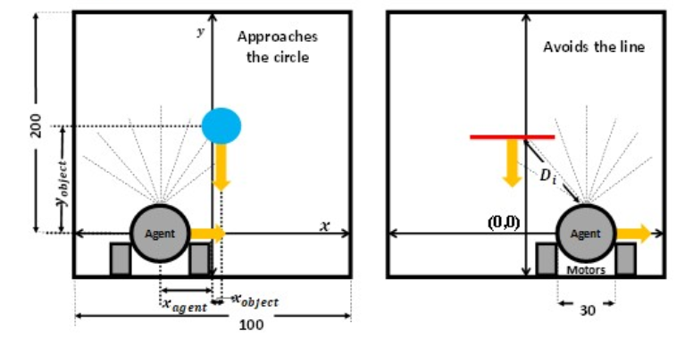
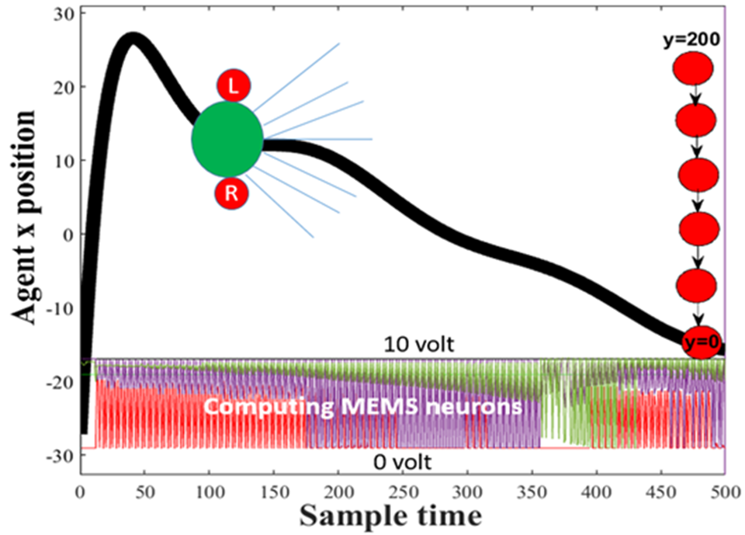
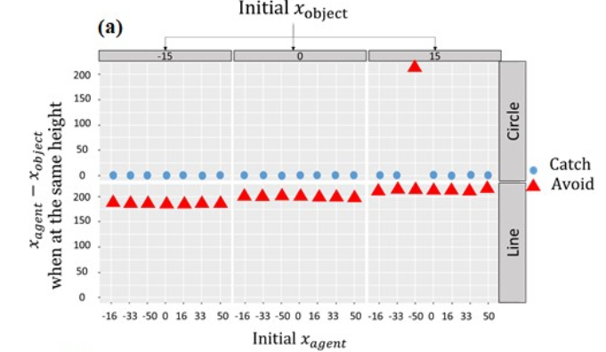
A MEMS-Neuron Network (Mobile Robot)

Slide 14
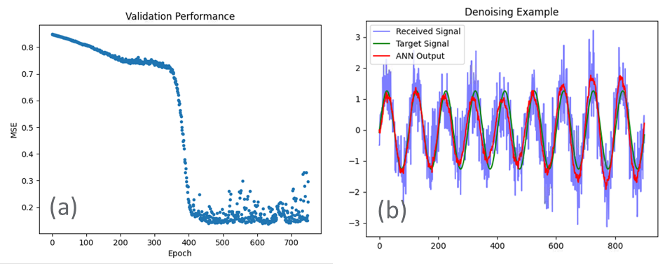
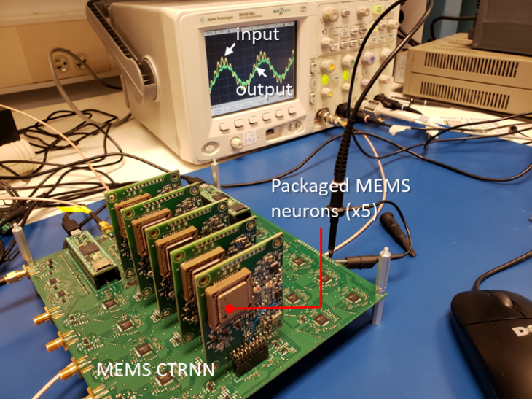
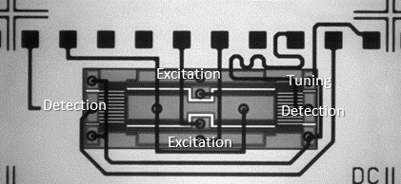
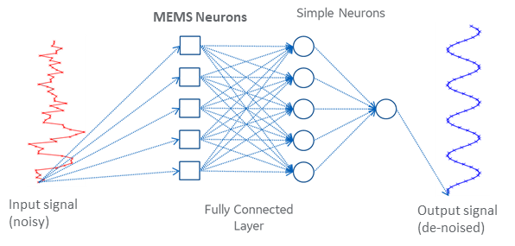
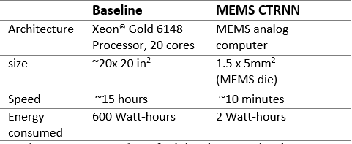
A MEMS-Neuron Network (de-noising Problem)
MEMS Analog computer hardware
MEMS-based CTRNN architecture
Solving the de-noising problem using the MEMS network
MEMS Neuron
Computation performance benchmarking: MEMS analog computer vs digital computer

Slide 15
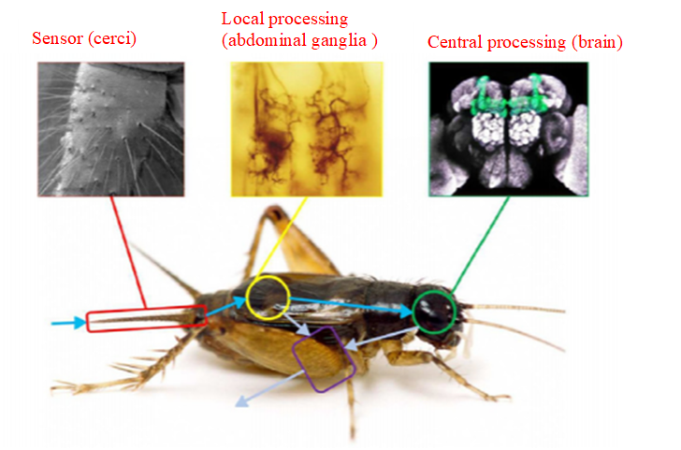
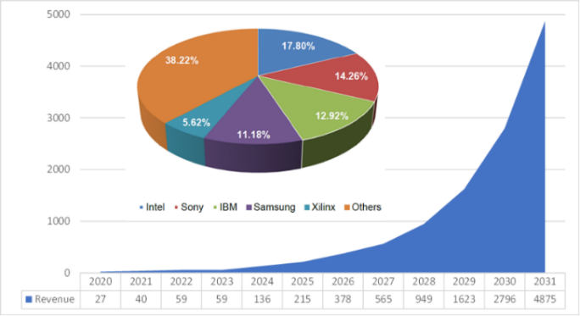
Sensing and Computing Unit : Inspired By Insects
Has an integrated sensing and computing units through its body
10 years revenue in millions of the bio-inspired sensing and computing

Slide 16
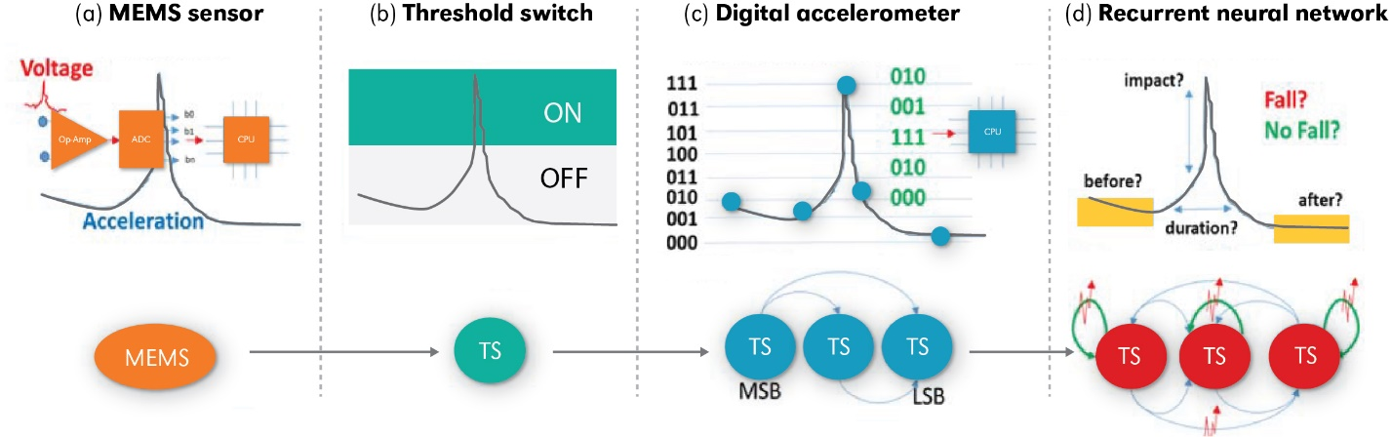
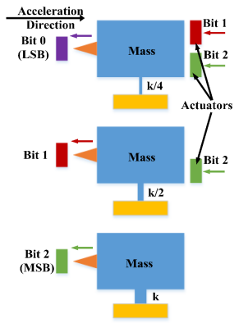
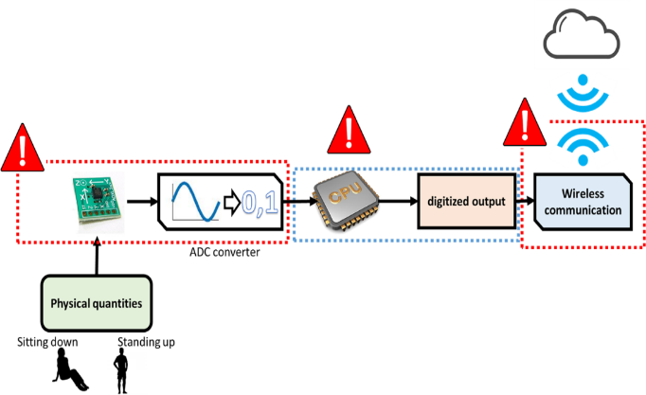
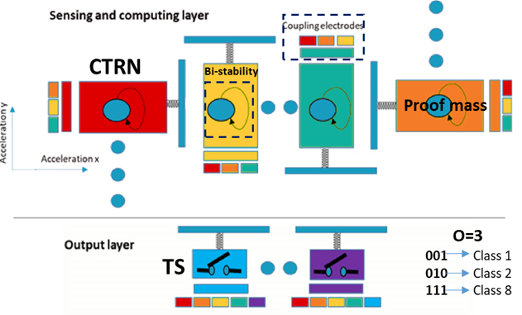
The MEMS Sensing and Computing Journey

Slide 17
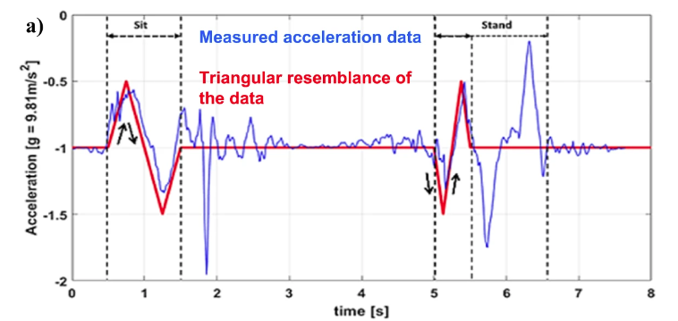
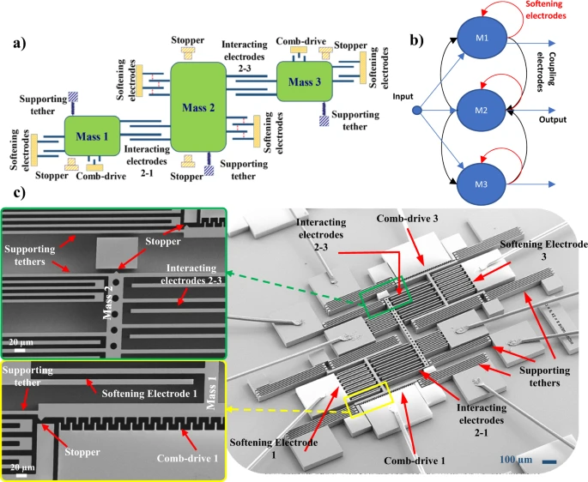
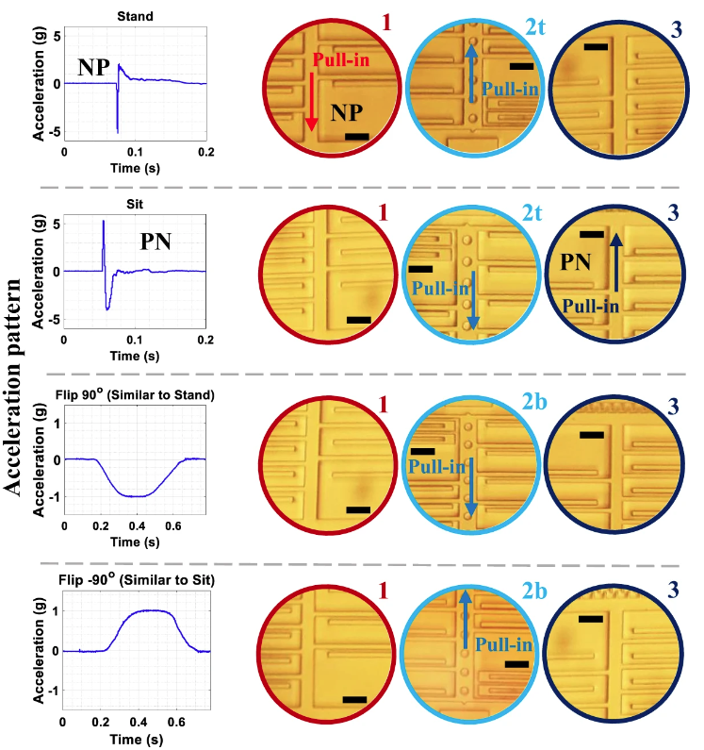
Activity Recognition
Stand
Sit

Slide 18
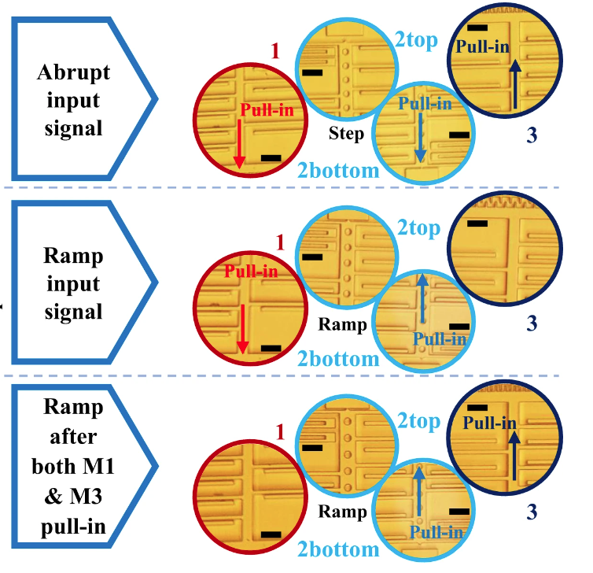
Signal Classification
0.44 Tera acceleration calcification using a single charge of a common wearable battery
Triangle signal
Square signal

Slide 19
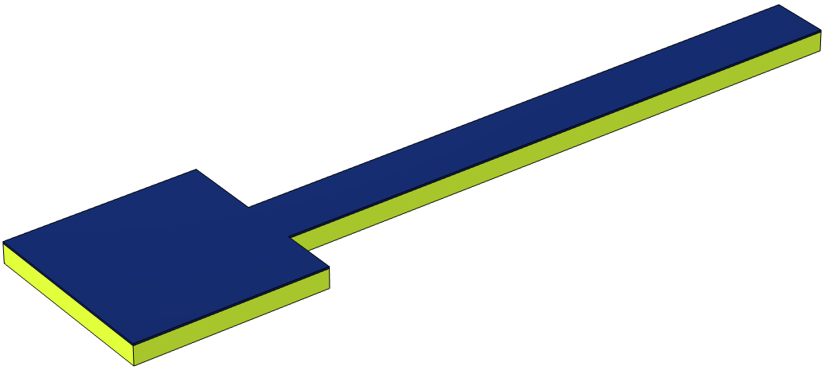
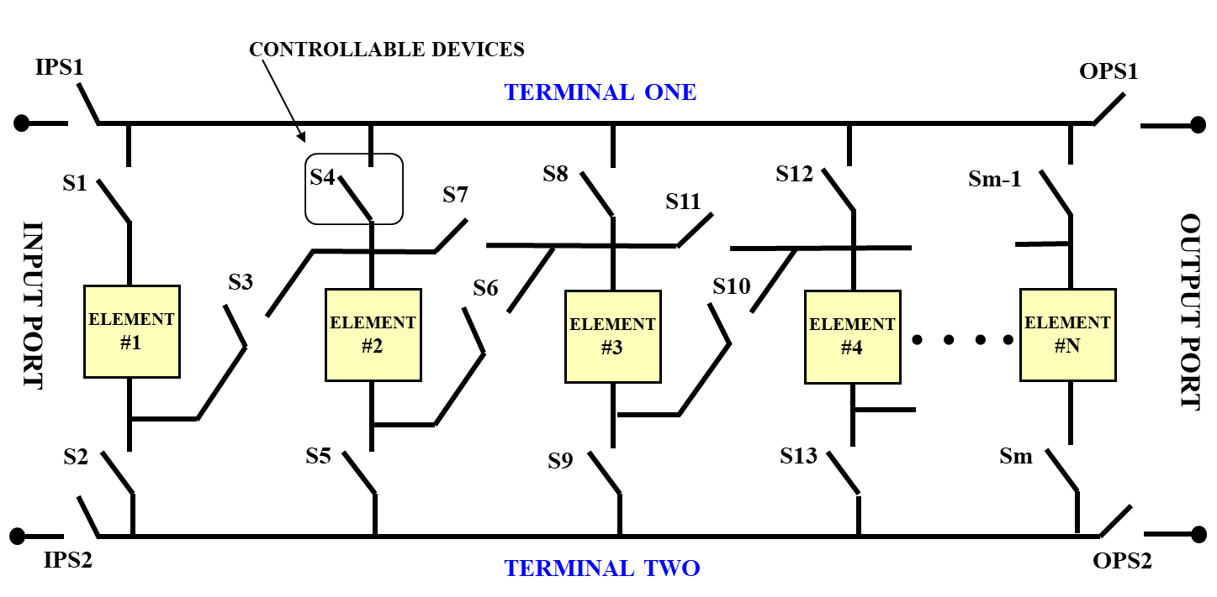
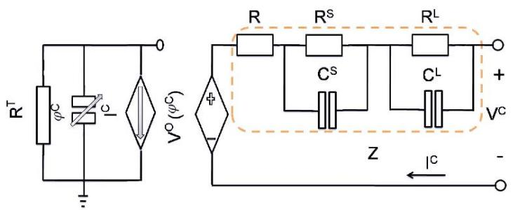
Develop improved sensing and switching technologies for the Reconfigurable battery system (RBS)
Electrostatic MEMS actuator as a control switch
Design is based on a composite microbeam, with a polysilicon layer and a magnetostrictive layer, in an electrostatic configuration.
Elastic modulus of magnetstrictive material is dependent on the magnetic field.
The pull-in voltage (voltage to cause switching) depends on the Elastic modulus of magnetostrictive material.
A switch can be designed to switch ON/OFF based on SOC/magnitude of the applied magnetic field.
Proposed sensor design a cantilever composite beam with a polysilicon layer (yellow ) a magneto-strictive material (dark blue).
Integrated transistor (MOSFET)
Relays/Contactors
MEMS
Battery Cell
Battery Module
Battery Pack
Reconfigurable Architecture
Funded by the NEBRASKA CENTER FOR ENERGY SCIENCES RESEARCH

Slide 20
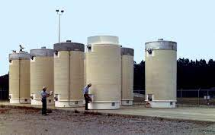
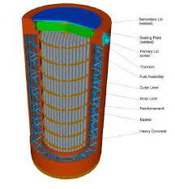
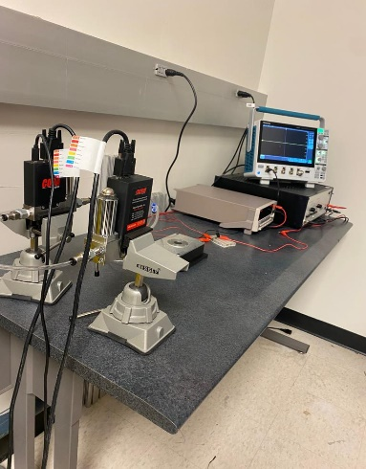
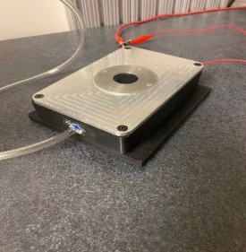





External Sensing for Spent Fuel Storage Canister using MEMS Helium Sensors

Slide 21



What Is Next?
Deep MEMS network
Structural health monitoring

Slide 22


What Is Next?
Deep MEMS network
Additive manufacturing in-process mentoring

Slide 23





Dynamic Filed Theory
Neural field PDE
MEMS beam equation

Slide 24



PAD treatment prediction

